Slide 1
MEXICO
BY GABE TEMPEL & KAYLA JOHNSON

Slide 2
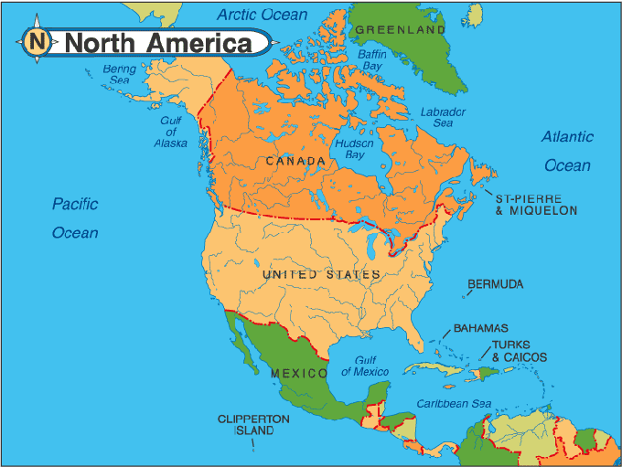
MEXICO

Slide 3
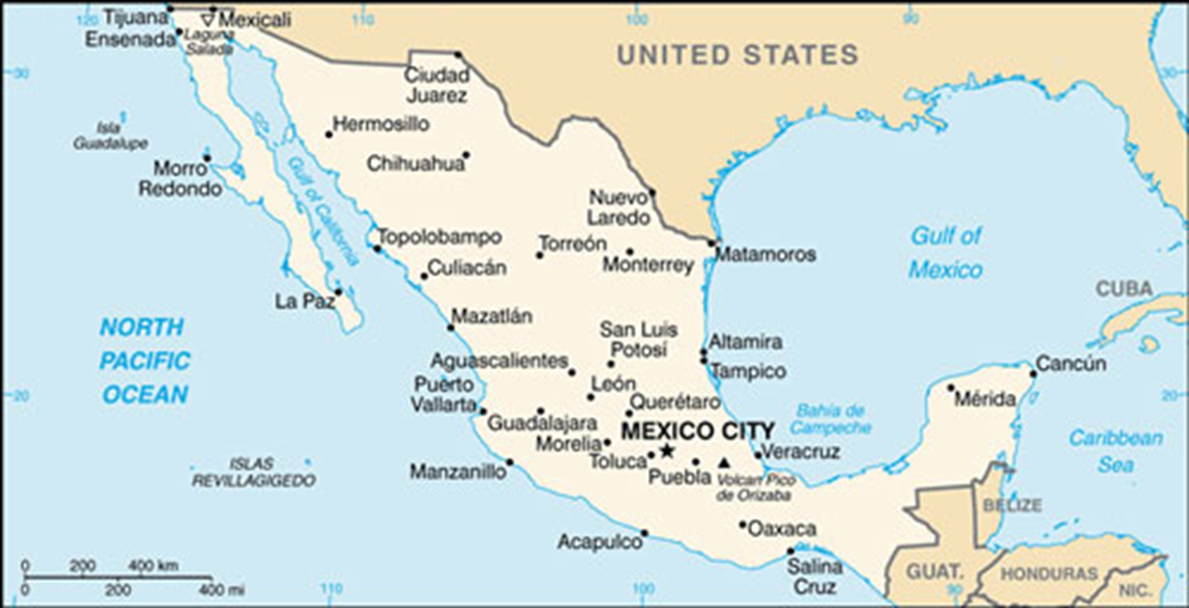
MEXICAN CITIES & CAPITAL

Slide 4
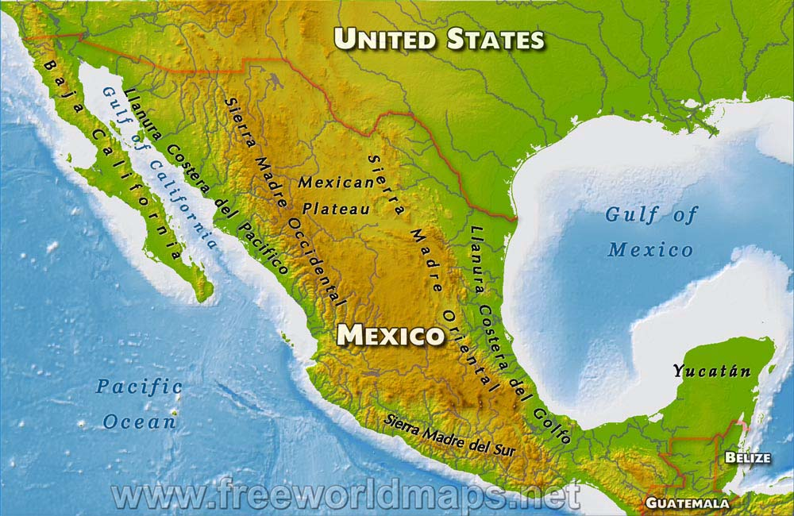
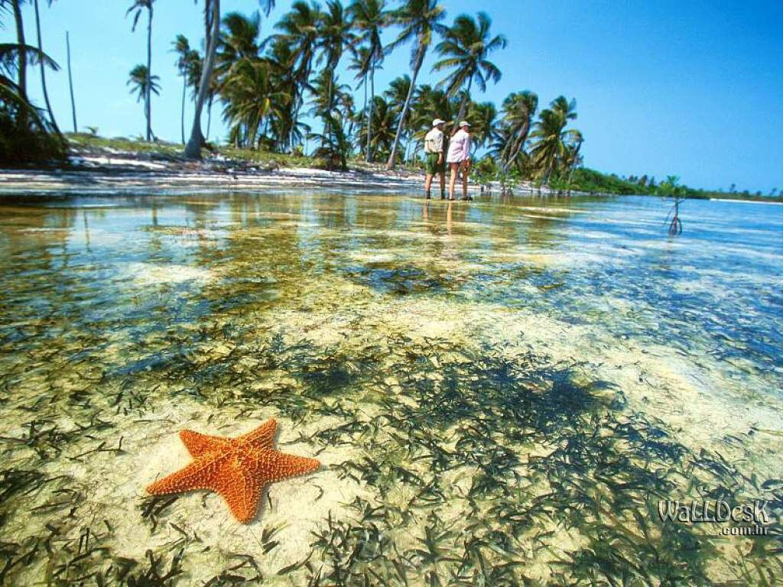
Physical Description

Slide 5
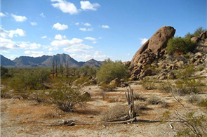
Physical Description
Mexico Is mostly covered by mountains and plateaus (Western Sierra Madre, Eastern Sierra Madre, Sierra Madre de Sur, and The Mexican Plateau).
Tropical in the Yucatan Peninsula.
Surrounded by water (Pacific Ocean to the west and Gulf of Mexico to the east).
Very dry region with lots of mountains, the vast Chihuahuan desert in the north, and very few rivers running through the whole country.

Slide 6
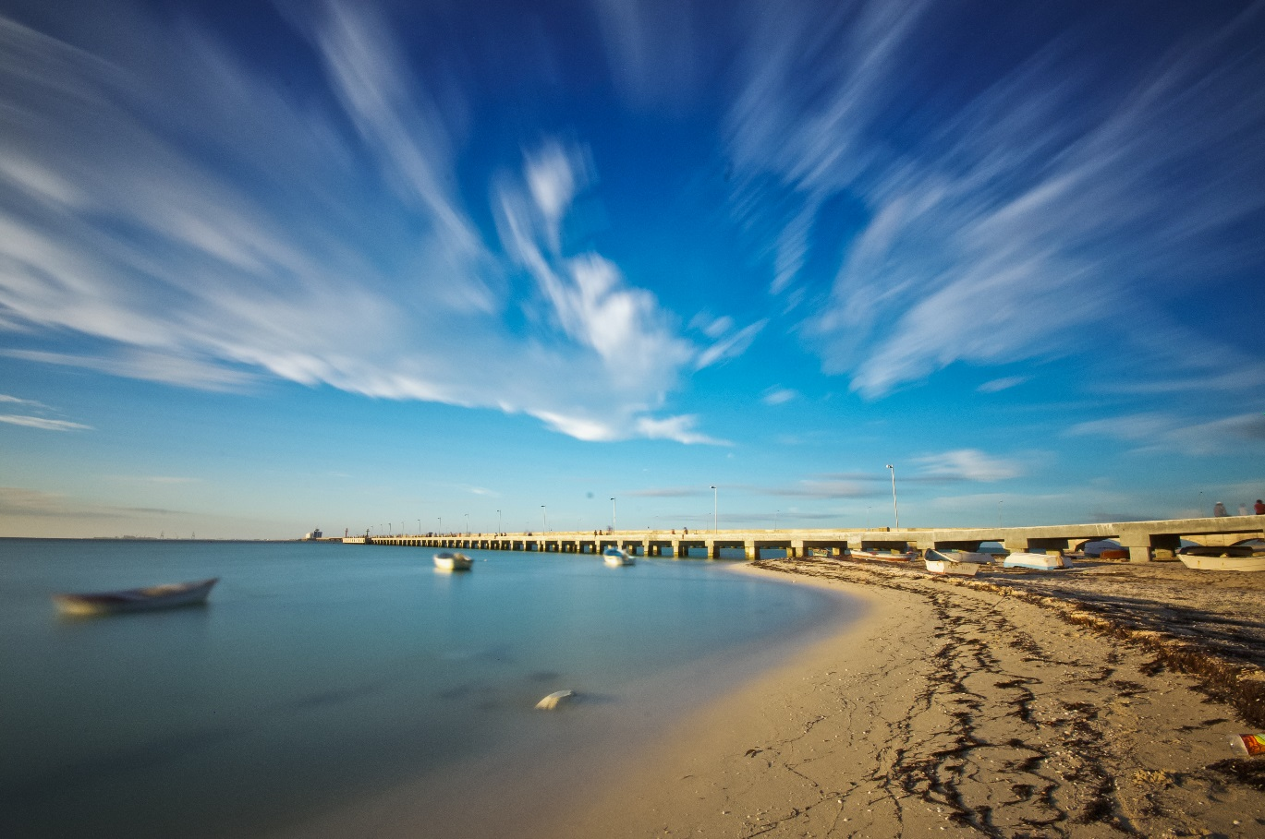
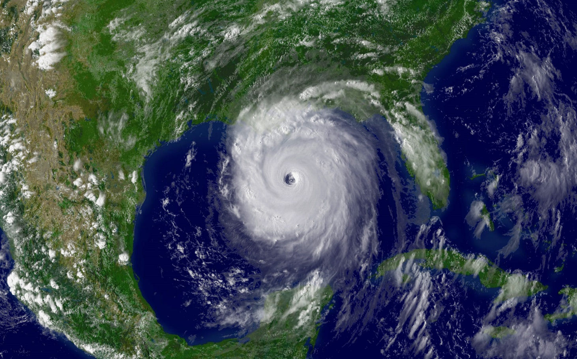
Climate

Slide 7
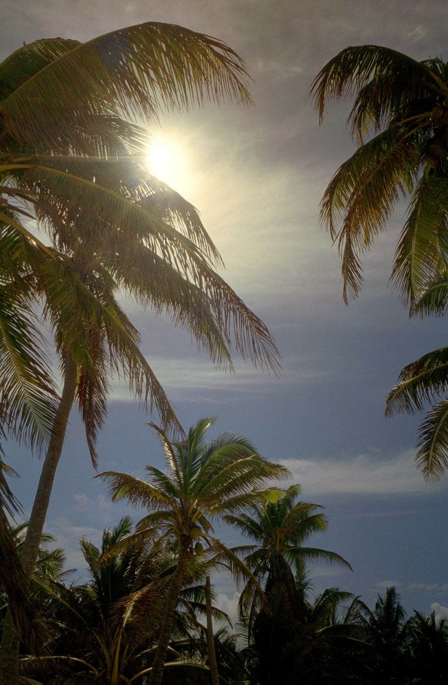
Climate
In Northern Mexico it is very dry and desert like.
In the Yucatan Peninsula it is tropical.
Sunny all the time.
Hurricanes during the hurricane season in the Gulf of Mexico.

Slide 8
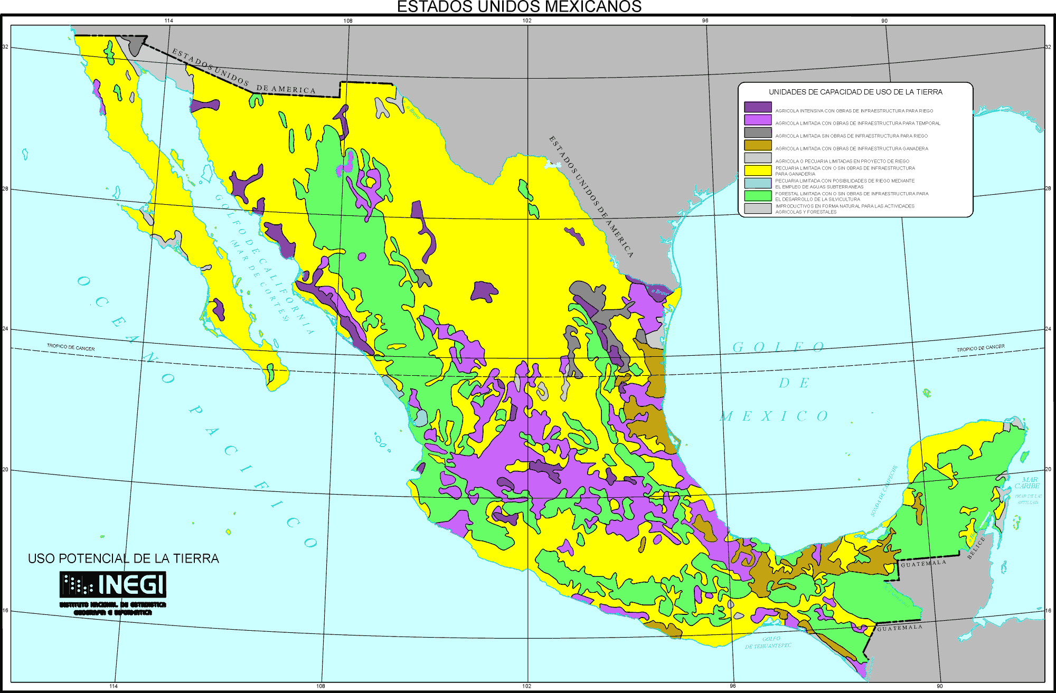
MEXICAN LAND USE

Slide 9
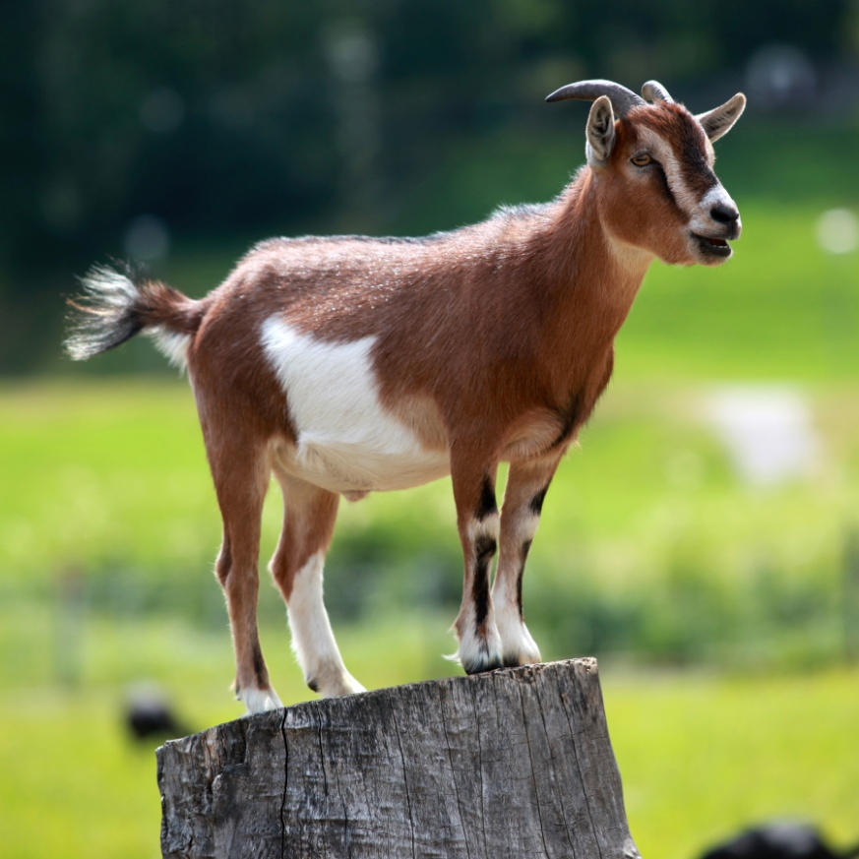
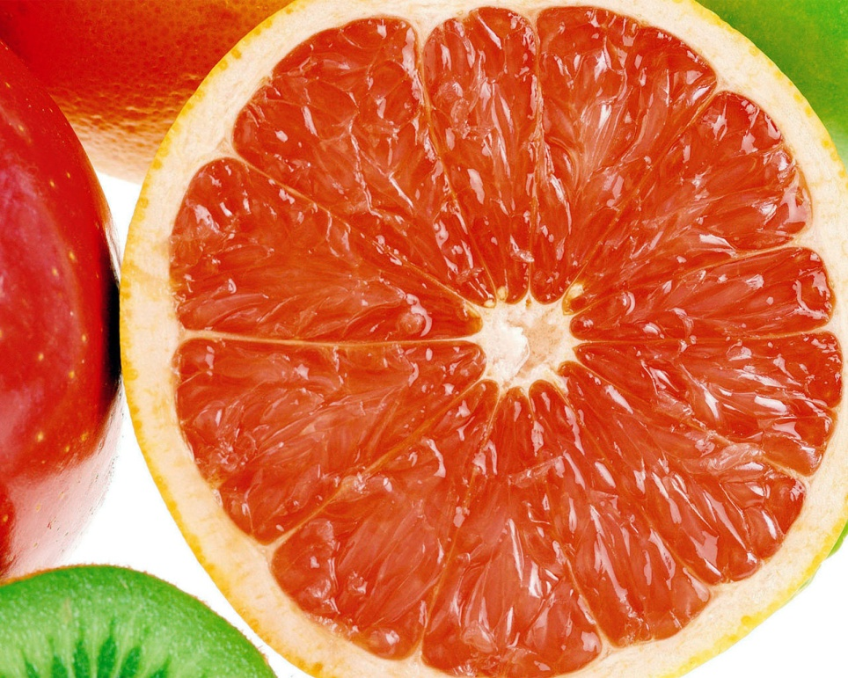
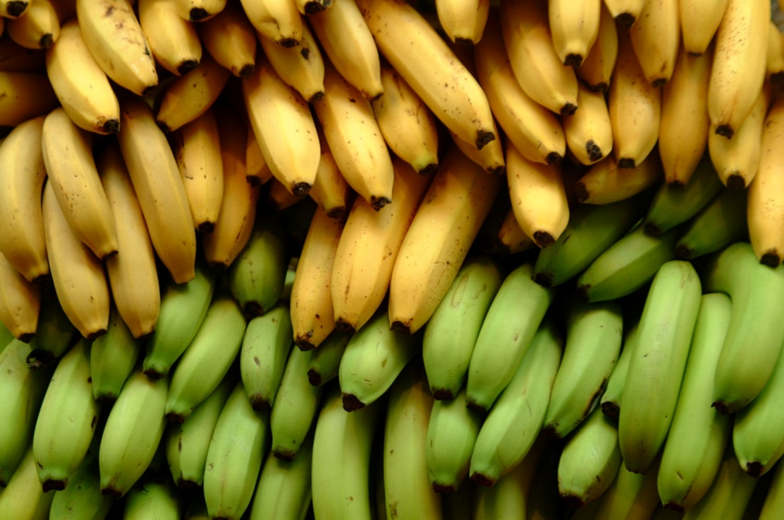
Resources

Slide 10
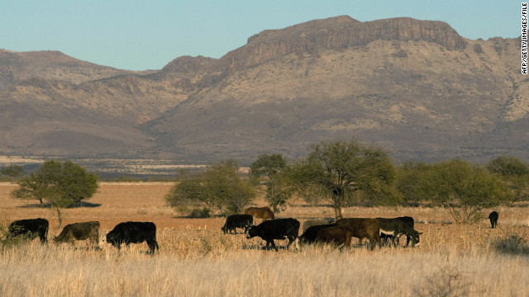
Resources
Fish, several species of cattle, pigs, goats, and poultry.
Grow corn, sorghum, beans, grapefruit, limes, coconut oil, peaches and nectarines, pears, strawberries, and grapes.
Corn and wheat imports from the U.S.
Exports veggies, and fruit and among the top 10 producers on avocado, cacao, coffee, lemon, mango, tomato, orange, sugarcane, honey and banana. Mostly exported to U.S, Europe, and Japan during winter season.

Slide 11
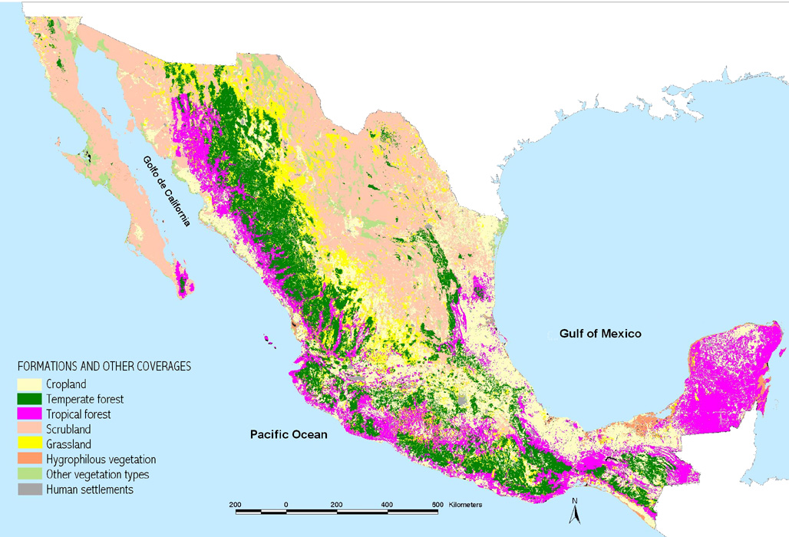

Slide 12
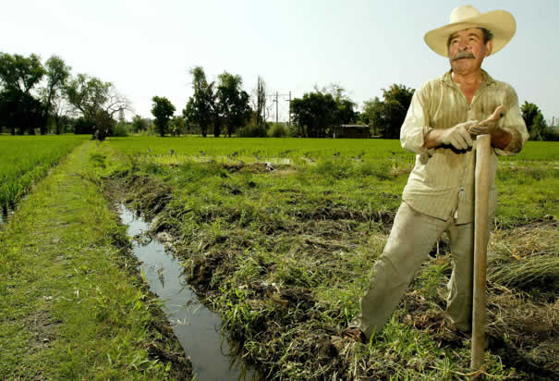
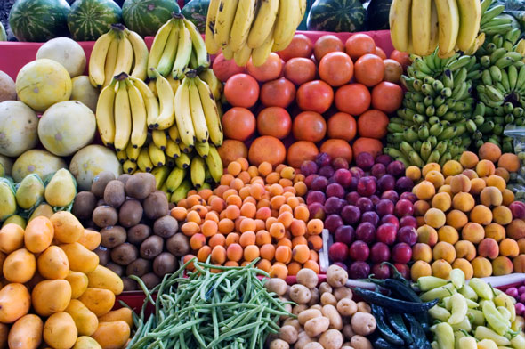
Agriculture

Slide 13
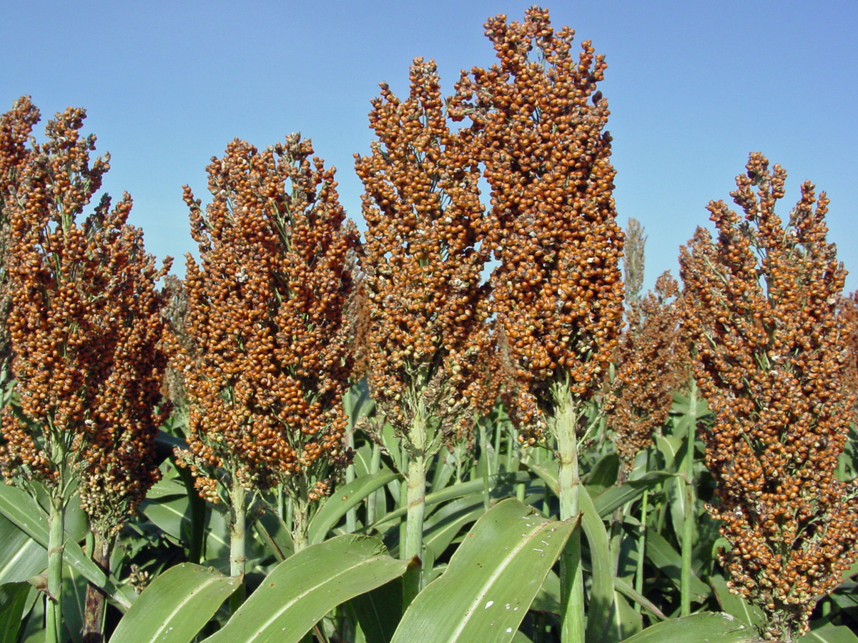
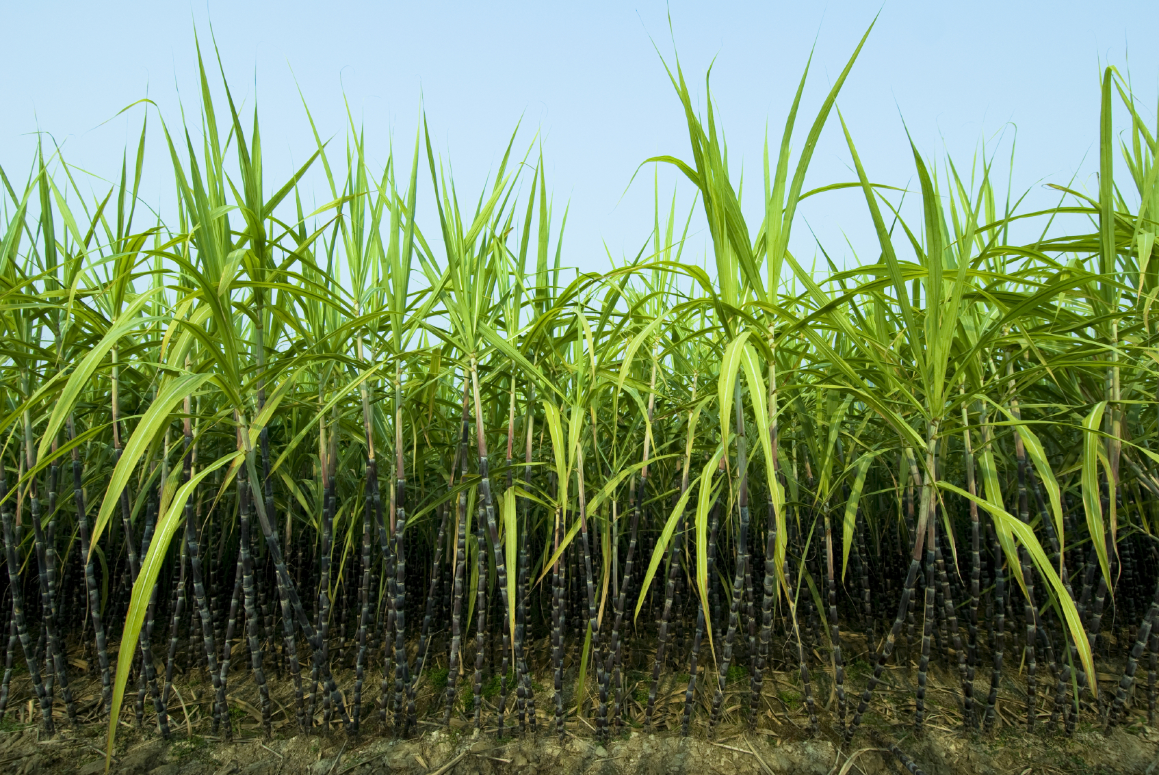
FOOD GROWN IN MEXICO
Grains
  Corn
  Wheat
  Rice
  Sorghum
  Beans
Coffee
Sugar Cane
Cocoa
Fruits
  Bananas
  Oranges
  Lemons
  Limes
  Mangos
  Other tropical fruits

Slide 14
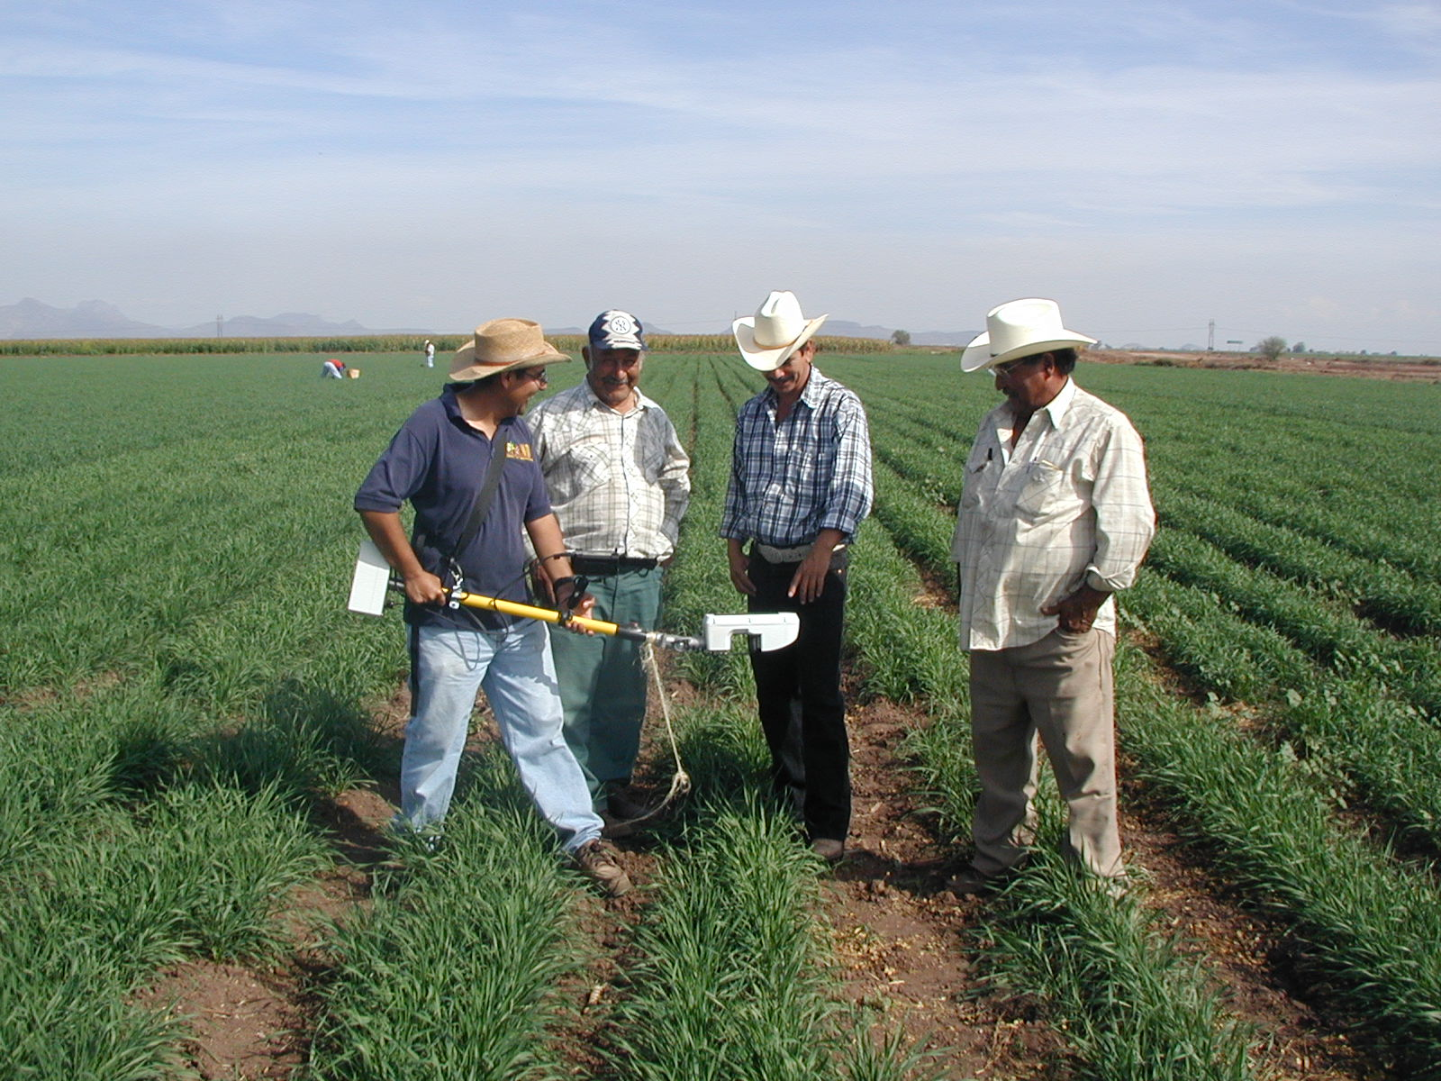
Land Use
Mexico has 1/10 to 1/8 of the countries total area planted annually.
They grow tropical fruits and veggies that require a lot of sun. Appropriate for this region because Mexico is always hot and is down in the tropic of cancer where it’s warmer.

Slide 15
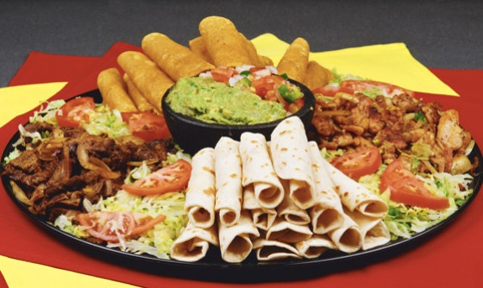
MEAL PATTERNS
In the US, we eat around our work schedule, while Mexicans work around their eating schedule. Not only are their eating patterns different, but their diet as well is also unique. Mexicans generally eat a traditional diet consisting of healthy foods, rich in taste.

Slide 16
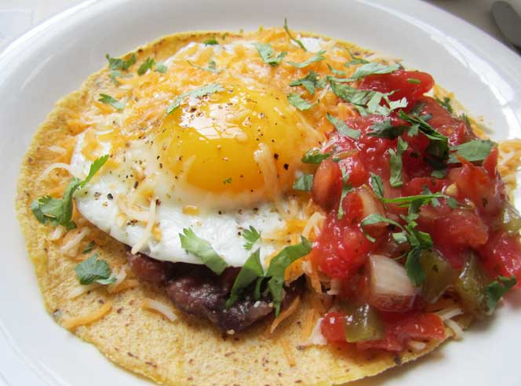
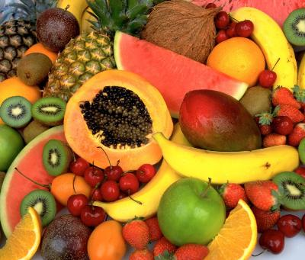
BREAKFAST
Breakfast between 7:00am and 10:00 am
Breakfast in Mexico can range from a simple cup of coffee to a huge spread featuring “huevos rancheros” (corn tortillas filled with fried eggs and a sauce of chili, tomato and onion.
  Sweet breads
  Tropical Fruits
  Toast
  Granola
  Yogurt

Slide 17
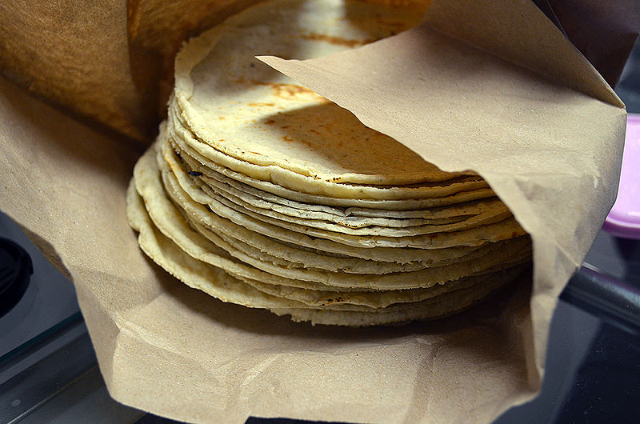
LA COMIDA (LUNCH)
Between 1:30pm and 4:00pm
Lunch is the main meal of the day
Lunch consists of an appetizer, a soup or salad and the main course: seafood, meat or poultry, rice and beans and hot tortillas.

Slide 18
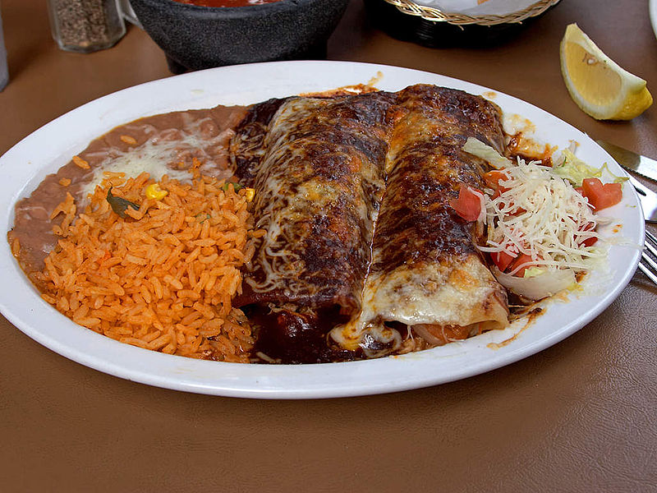
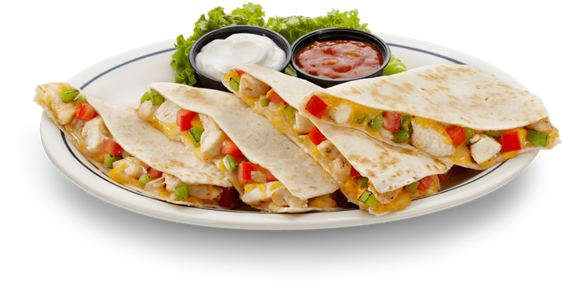
La Cena (Dinner)
Between 8:00pm and 9:00pm
Lighter meal of the day
Often consists of soup, tacos, enchiladas, or quesadillas

Slide 19
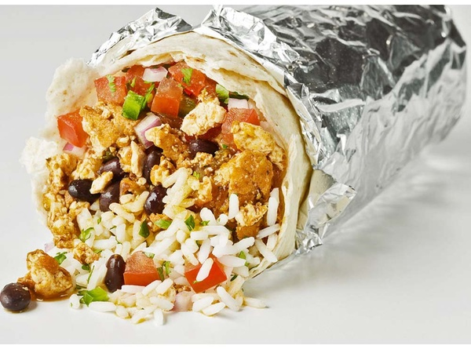
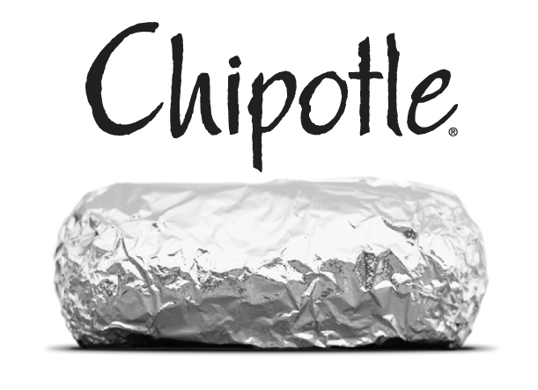
Chipotle

Slide 20

Mexican Family:
The culture of Mexican families has a strong foundation in unity. Mexico's divorce rate is one of the lowest in the world and generations of families typically live in the same neighborhood or in the same house, which reflects the dedication to supporting family members and displaying loyalty no matter what happens.

Slide 21
Typical Day In Mexico:
Kids-
Kids start their day off with breakfast and then go off to school. At noon the kids go home to have lunch with their family, then back to school. After school the kids go to their after school activities like sports. After activities they go home to have supper with the family.
Adults-
Parents start their day off with breakfast with their kids and then go off to work. At noon they go home and have lunch with their family, then back to work. After work they go home to their family go supper.

Slide 22
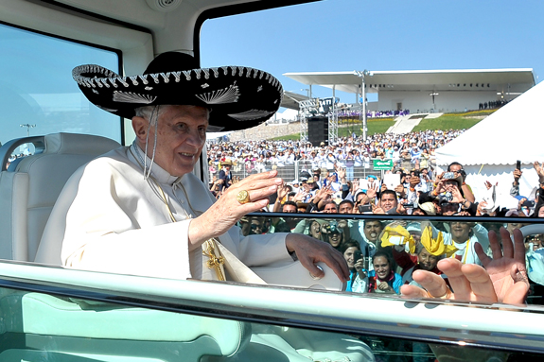
Religion:
Roman Catholic 76.5%
“There is no official religion in Mexico, as the constitution guarantees separation of church and state. However, more than nine-tenths of the population are at least nominally affiliated with Roman Catholicism. The Basilica of Guadalupe, the shrine of Our Lady of Guadalupe, Mexico’s patron saint, is located in Mexico City and is the site of annual pilgrimage for hundreds of thousands of people, many of them peasants. Throughout Mexico are thousands of Catholic churches, convents, pilgrimage sites, and shrines.”

Slide 23
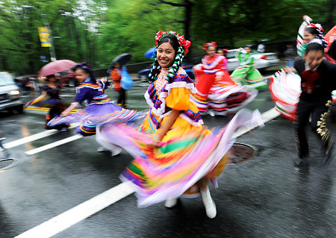
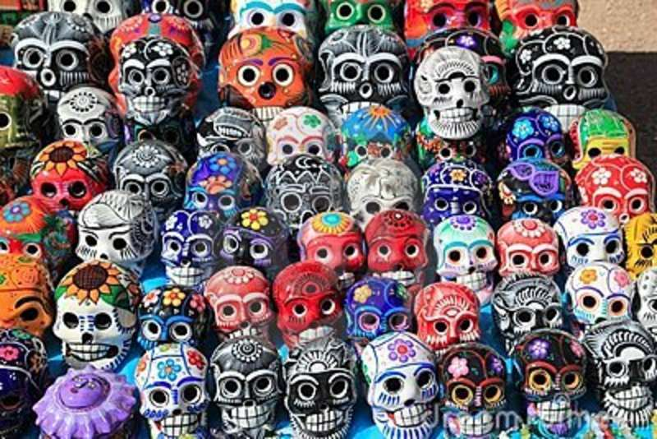
Mexican Holidays:

Slide 24
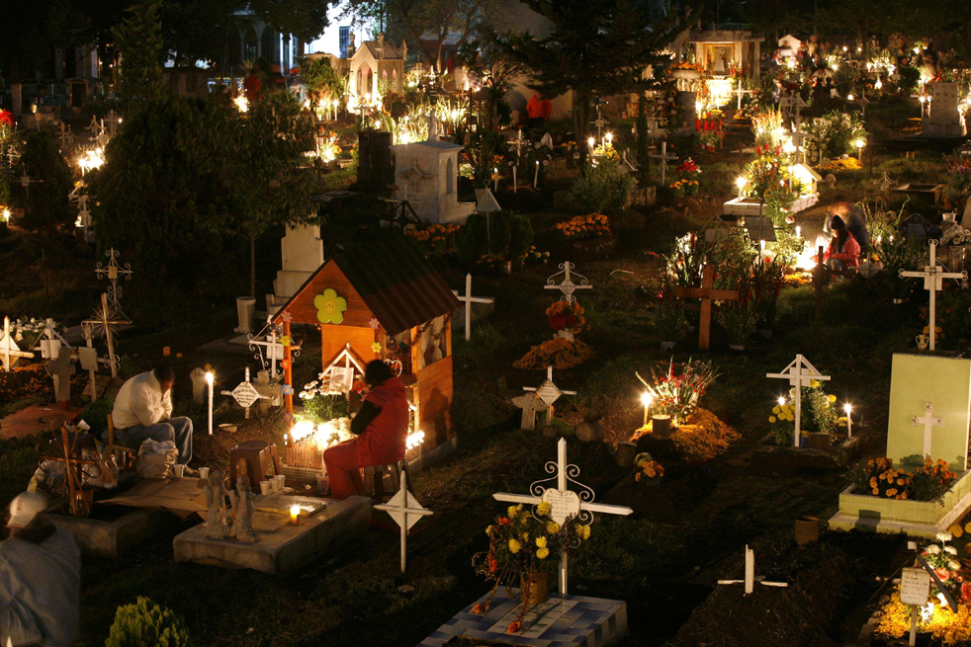
Mexican Celebrations
Any holiday in Mexico, whether it’s Cinco de Mayo or Los Dias de Los Muertos, it is a time to celebrate and be happy. When they celebrate Los Dias de Los Muertos they go out to the grave yard and decorate their loved ones tombs to celebrate their life.

Slide 25
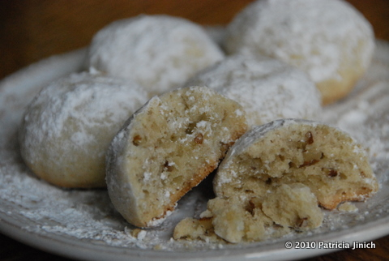
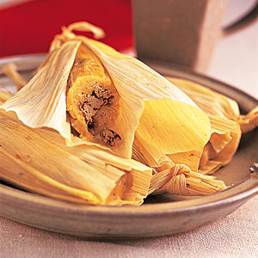
Celebration Foods
Tamales play a major role in every Mexican celebration.
Ice Cream
Mexican Wedding Cookies

Slide 26
Mexican Wedding Cookies
Directions:
In a medium bowl, cream the butter and sugar. Stir in vanilla and water. Add the flour and almonds, mix until blended. Cover and chill for 3 hours.
Preheat oven to 325 degrees.
Shape dough into balls or crescents. Place on an unprepared cookie sheet and bake for 15 to 20 minutes in the preheated oven. Remove from pan to cool on wire racks. When cookies are cool, roll in confectioners' sugar. Store at room temperature in an airtight container.
1 cup butter
1/2 cup white sugar
2 teaspoons vanilla extract
2 teaspoons water
2 cups all-purpose flour
1 cup chopped almonds
1/2 cup confectioners' sugar

Slide 27
Tamales
Tamale Filling:
1 1/4 pounds pork loin
1 large onion, halved
1 clove garlic
4 dried California chile pods
2 cups water
1 1/2 teaspoons salt
Tamale Dough:
2 cups masa harina
1 (10.5 ounce) can beef broth
1 teaspoon baking powder
1/2 teaspoon salt
2/3 cup lard
1 (8 ounce) package dried corn husks
1 cup sour cream
Directions
Place pork into a Dutch oven with onion and garlic, and add water to cover. Bring to a boil, then reduce heat to low and simmer until the meat is cooked through, about 2 hours.
Use rubber gloves to remove stems and seeds from the chile pods. Place chiles in a saucepan with 2 cups of water. Simmer, uncovered, for 20 minutes, then remove from heat to cool. Transfer the chiles and water to a blender and blend until smooth. Strain the mixture, stir in salt, and set aside. Shred the cooked meat and mix in one cup of the chile sauce.
Soak the corn husks in a bowl of warm water. In a large bowl, beat the lard with a tablespoon of the broth until fluffy. Combine the masa harina, baking powder and salt; stir into the lard mixture, adding more broth as necessary to form a spongy dough.
Spread the dough out over the corn husks to 1/4 to 1/2 inch thickness. Place one tablespoon of the meat filling into the center. Fold the sides of the husks in toward the center and place in a steamer. Steam for 1 hour.
Remove tamales from husks and drizzle remaining chile sauce over. Top with sour cream. For a creamy sauce, mix sour cream into the chile sauce.

Slide 28
Work Cited
http://family.lovetoknow.com/family-values/mexican-family-culture
http://www.worldatlas.com/webimage/countrys/namerica/mx.htm
http://www.climate-zone.com/climate/mexico/
http://wiki.answers.com/Q/What_is_the_main_agricultural_product_in_Mexico#slide=1
http://www.britannica.com/EBchecked/topic/379167/Mexico/27393/Agriculture-forestry-and-fishing
http://www.britannica.com/EBchecked/topic/379167/Mexico/27386/Religion
http://www.religionfacts.com/religion_by_country/religion_in_mexico.htm
http://www.elmonterey.com/extras/festivals-and-celebrations/

