Slide 1
Culinary travel guide
China!
By: Emily Grav & Kaila Meyer

Slide 2
Asia

Slide 3
China and its Provinces
China itself is the third largest country, following Russia and Canada. It has many provinces similar to our states. China is bordered by 14 countries: Korea, Vietnam, Laos, Burma, India, Bhutan, Nepal, Pakistan, Afghanistan, Tajikistan, Kyrgyzstan, Kazakhstan, Mongolia, and Russia. It’s marine neighbors, eight countries include: North Korea, South Korea, Japan, Philippines, Brunei, Indonesia, Malaysia and Vietnam.

Slide 4
Physical features

Slide 5
Physical Features Cont.
China is a huge landscape and has many different features. It includes plateaus, plains, basins, foothills, and mountains. These features take up over 2/3 of the landscape. The Qinghai-Tibet Plateau take up the Western portion of the country with an average height of over 4,000 meters.
The second third of the country is taken up by large basins and plateaus averaging between 1,000-2,000 meters.
The final third consists of broad plains dotted with foothills close to 500 meters. This area has some famous plains such as the Northeast, North China, and Middle-Lower Yangtze Plains. These lands produce the majority of China’s crops.

Slide 6
Physical Features Cont.
There are many rivers and lakes in China.
The Yangtze is the longest river in China and even in Asia. It is the third-longest in the world.
The Yellow River, also called “The Mother River of the Chinese People,” is just behind the Yangtze in length.
The Yarlung Zangho River flows into the Indian Ocean, and the Irtysh River goes into the Arctic.
In China lakes are also important.
In the northwest, many of the lakes are salt-water. Qinghai Lake is the largest.
The southeast region contains mostly fresh water.

Slide 8
Weather of China!
There are 6 temperature zones in China.
Cold-Temperate Zone
Mid-Temperate Zone
Warm-Temperate Zone
Subtropical Zone
Tropical Zone
Plateau Climate Zone
During the summer there is Monsoon season.
A monsoon is a lot of rain throughout a short amount of time.
The monsoon seasons are different for each area because the wind changes where it goes.
http://www.travelchinaguide.com/climate/

Slide 9
china’s natural resources
China is very rich in natural resources.
China has very rich farmland. Even though this only amounts to about 10% of the total land area, China is a major producer of wheat, corn, rice and other cash crops.
This country also takes advantage of its many freshwater lakes and raises shrimp, fish and other aquatic products.

Slide 10
China’s natural resources cont.
China is a leading producer of cotton which is grown throughout the country. It also raises silkworms, a traditional art practiced in central and southern china.
The livestock population is very large, but pigs and fowl are the most common farm animal. In western China, sheep, goat and camel are raised. Cattle, water buffalo, horses, mules, and donkeys are also being raised.
There is also a large fishing industry which accounts for 1/3 of the world’s fish production.

Slide 11
agriculture
Only about 15% of the land in China can be cultivated. So to overcome this problem they’ve started to plant close to or even in large cities. bok choy-like greens are grown in a square outside railway stations in Ezhou. So non-staple foods (mostly vegetables and milk) can now be produced in urban cities like the capital, Beijing.
Rice is the most important crop. It takes up about 25% percent of the farmland. Wheat follows close behind in matter of importance.
Other crops like potatoes and fruit are grown in various regions throughout China. Tea, sugarcane and sugar beets are other important food crops.
Citrus fruit, however is an important cash crop. Mandarins are the most popular, roughly doubling the output for oranges.

Slide 12
Agriculture’s importance
China’s limited space for farming has resulted in chronic food shortages throughout its history. Production efficiency has increased, however efforts to expand into northern and western China have had little success. The region is generally colder and drier than other farmlands to the east. Also, since the 50’s, farm space has been under pressure from increasing urbanization.

Slide 13
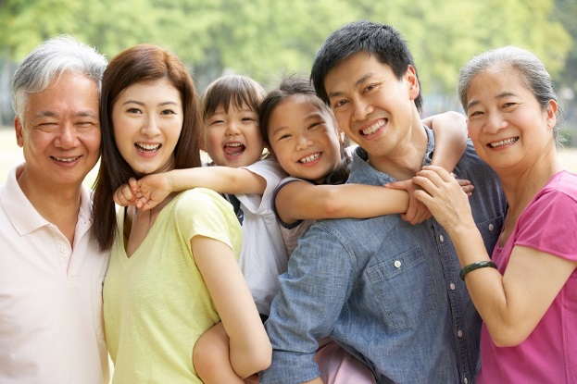
A Traditional Family
The typical Chinese family has changed over the this last decade. It has gone from typically having anywhere from between two to four generations living in one household to having about one generation living in the house.
The family is used to be focused on having a large size family but now it is focused on having a smaller family
http://globerove.com/china/chinese-culture-family-life/1781

Slide 14
A typical day for students
They wake up at somewhere between 6 and 7 AM
They eat breakfast with their family before they have to leave for school
Most students walk to school because it is not very far away
Each class is about 45 minutes long and they have a 10 minute break between every class
Typically kids don’t have very much free time because they are either in class or at home doing homework
Chinese students do not get a summer break

Slide 15
Religion
The country of China practices many religions. The main few are Buddhism, Taoism, Islam, Catholicism and Christianity.
Most of the Chinese people practice Taoism, Christianity, or Buddhism.
There are nearly 13 thousand Buddhist temples and over 33 Buddhist colleges.
Taoism has been practiced for 18 hundred years, since the second century AD. It advocates worship of natural objects and ancestors
Christianity was introduced in the 19th century and spread greatly after the 1840’s. As of today there are around ten million Chinese Christians.

Slide 16
Festivals!
There are many different festivals that the Chinese celebrate throughout the year
Three of them are : Spring Festival, Lantern Festival, and the Winter Solstice Festival

Slide 17
Spring Festival
Families get together like they would for Christmas in the United States
The Spring Festival is on the 1st day of the 1st lunar month
Celebrate the new year coming in
People clean and decorate to bring in a happy atmosphere
The food is very luxurious on this day. Most people eat niangao (a cake made of rice flour). Others eat jiaozi or dumpling for breakfast.

Slide 18
Lantern Festival
The Lantern Festival falls on the 15th day of the 1st lunar month (usually February or March).
This festival is celebrated by watching lanterns. The Buddhists used to light lanterns to celebrate the Buddha.
Some people put riddles in the lantern and if a visitor figures out the riddle, they bring the lantern to its owner and get a gift.
They typically eat yuanxiao, a rice dumpling. It is filled with a sweet paste. They are eaten to denote harmony, union, and happiness for the family.

Slide 19
Winter Solstice Festival
The Winter Solstice became a festival during the Han dynasty.
This day is celebrated with a day of rest for officials and common people. All travel is stopped and businesses are closed.
People get together and share food with friends and family.
Some people have dumpling soup whereas others have a meal of red-bean and rice to drive away evil.

Slide 20
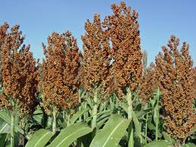
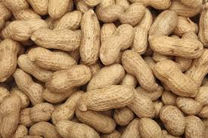
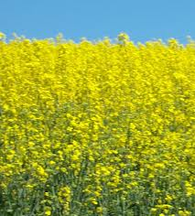
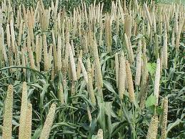
Food grown
Sorghum
China is a leading producer of food crops, employing over 300 million farmers.
China produces mainly rice, wheat, potatoes, sorghum, peanuts, tea, millet, barley, cotton, oilseed, pork and fish.
Even though China only accounts for 10% of the arable land world wide, it produces food for 20% of the world’s population.
Barley
Peanuts
Oilseed
Millet

Slide 21
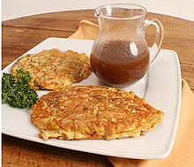
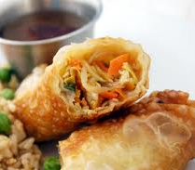
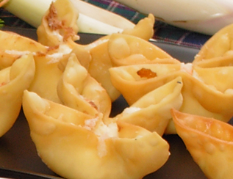
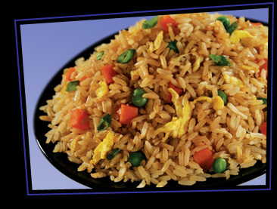
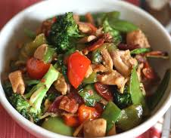
Popular Foods in China
Egg Foo Yung
Egg Roll
Crab Rangoon
Fried Rice
Stir Fry

Slide 22
Traditional Chinese Meals
They normally start their meals with a cold dish that is light and simple.
After the cold dish is done they move on to the main dishes which is normally hot and have vegetables included somewhere.
The last course is soup but then followed by a starch such as rice or noodles.
Basic etiquette for a daily meal:
Do not stick your chopsticks upright in the rice bowl. It is found as a form of disrespect
Make sure the spout of the teapot is not facing anyone. If it is facing at anyone it is impolite.
Do not tap on your bowl with your chopsticks. That is what beggars do and what people do if the food is coming too slow
http://www.chinafacttours.com/facts/tradition/chinese-eating-custom.html

Slide 23
Other festival foods
The dumpling is a very festival food that is now enjoyed world wide. It is most popular during the Spring Festival.
Fish is very popular especially at what’s known as the Reunion Dinner. The head and tail are left to represent completeness.
Another popular one is the Spring Roll. Fresh vegetables are wrapped inside and it is eaten to welcome the new spring.

Slide 24
Works Cited
http://xiangyaoyu.com/family-structure-in-china.html
http://english.people.com.cn/92824/92845/92875/6442434.html
http://www.china.org.cn/english/features/Festivals/78322.htm
http://www.china.org.cn/english/features/Festivals/78320.htm
http://www.china.org.cn/english/features/Festivals/78308.htm
http://www.chinahighlights.com/travelguide/chinese-food/eight-chinese-dishes.htm
http://www.chinafacttours.com/facts/tradition/chinese-eating-custom.html
http://www.travelchinaguide.com/tour/food/chinese-cooking/festival-food.htm
http://www.timeforkids.com/destination/china/day-in-life
http://nypost.com/2008/09/09/a-day-in-the-life/
http://www.travelchinaguide.com/climate/
http://www.travelchinaguide.com/intro/geography/
http://en.wikipedia.org/wiki/Agriculture_in_China
http://www.mapsofworld.com/china/important-cities.htm
http://www.travelchinaguide.com/essential/holidays/new-year/food.htm

